Slide 1
Investors Presentation
March 2023

Slide 2
Disclaimer
This presentation contains statements relating to Bank Muscat’s business, financial condition and results of operations from published information. Any statement or comment which has a meaning of future prospects and forward-looking are only predictions and are not guarantees of future performance and does not constitute any solicitation to buy or sell any products, services, stocks, bonds or to engage in any trading strategy and should not be relied upon or considered as advice for making any investment decisions.
A due caution must be exercised that any such forward-looking statements or comments are and will be, subject to both known and unknown risks, uncertainties and factors relating to the operations and business environments of the Bank that may cause the actual results of the Bank to be materially different from any future results expressed or implied in such forward-looking statements.
This presentation and discussions are for information purposes only. Any recipient of this presentation and discussion media must not communicate, reproduce, distribute or disclose through any media or refer to them publicly or privately, in whole or in part anytime without a written consent from the Bank.
By accepting delivery of this presentation, the recipient agrees to accept and be bound by the statements, restrictions and limitations set forth herein.
Notes:
To narrate the disclaimer points in slide.
تم إعداد هذا العرض المرئي من قبل بنك مسقط (ش.م.ع.ع) بناءً على معلومات متاحة للجمهور و منشورة مسبقاً، علماً بأن هذا العرض هو للنقاش و تبادل المعلومات فقط و لا يعتبر دعوة أو تشجيع للاستثمار في البنك او لشراء أي منتجات أو خدمات أو أسهم أو سندات، أو لاتخاذ أي قرارات استثمارية.

Slide 3
Table of Contents
 | I. Introduction | 4
 | II. Operating Environment | 7
 | III. Business Overview | 14
 | IV. Financial Performance | 22
 | V. Annexure | 27

Slide 4
I. Introduction

Slide 5




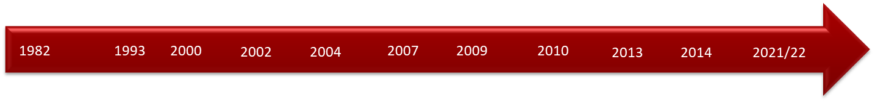
Bank Muscat at a glance
Overview
Major Shareholders % as of Mar 2023
Largest Omani bank with customer base over 2.4 mn and workforce of c.4,000
Rated Ba2 (positive) by Moody’s, BB (positive) by S&P & BB (positive) by Fitch
Established in 1982, headquartered in Muscat with 175 branches across Oman, 2 branches overseas, and 3 representative offices
  Fully diversified commercial bank offering corporate & retail banking services
  Meethaq – pioneer of Islamic Banking services in Oman, officially launched in 2013 with full fledged Sharia-compliant product and services offering
  Primarily domestic dominated operations
Listed on Muscat, London and Bahrain Stock Exchanges
Market cap c. RO 2.06 bn as of 31st Mar 2023
Key Financials
Bank Muscat Footsteps
Acquisition
of 49%
Stake in
BMI Bank
Muscat
Capital LLC
launched
Sale of Stake in Muscat Capital LLC by share swap with SICO Bahrain
Establishment
of Bank of
Muscat
Merger with
Commercial
Bank of Oman
Meethaq
launched
Merger between
Bank of Muscat
& Bank Al Ahli Al
Omani Listed on
the MSX in 1993
Acquisition of
the Bahraini
operations of
ABN AMRO
1st Branch in
Saudi Arabia
1st Branch in
Kuwait
Merger of BMI
Bank WITH Al
Salam Bank,
Bahrain

Slide 6

Bank Muscat – Key Highlights
Dominant Franchise in Oman
Largest Bank in Oman by total assets of RO 13.1 bn and a dominant domestic market share of total assets of 33.9%
The only bank in Oman to be designated a “D-SIB”
Largest branch network with 175 domestic branches
Strong Financial Metrics
Strong and stable shareholding
Stable and consistent financial performance
  Solid topline income growth
  Stable cost-to-income ratio despite business and infrastructure expansion
Strong and sustainable profitability metrics:
  Operating income 2018-2022 CAGR of 3.0%
Historical shareholding by:
  Royal Court Affairs: 23.63%
Stable shareholding by various Omani Pension funds ~ 24%
Stable Operating Environment
Solid Liquidity & Capital Position
Stable banking sector
Prudent regulatory environment
Stable political system in the Oman with excellent diplomatic relationship in the region
Positioned to benefit from growth in Oman with economic diversification focus, favourable population demographics and reform oriented government policies
High liquidity with 20.9% of the balance sheet composed of liquid assets
Strong capitalization levels offering room for substantial growth
CAR of 20.53% as of 31 Mar 2023 with Tier 1 CAR of 19.59%
Stable Asset Quality
Management
Conservative lending approach
Strong risk adherence architecture and policies
Robust asset quality metrics
Stable and experienced management with proven track record of successful organic and inorganic growth
Strong Board of Directors and corporate governance practices
2020 | 2019 | 2018 | 2017
1,186 | 1,227 | 1,160 | 1,132
1.57% | CAGR 20-17
Source: BM Financial results as of Mar-23, Central Bank of Oman Statistical Bulletin as of Feb-23 unaudited

Slide 7
II. Operating Environment

Slide 8
Oman Macro Overview
Overview
GDP, Public Debt (RO bn) & Borrowings as a % of GDP
Oman’s economic recovery is gaining traction. Oman has witnessed Fiscal and external surpluses in 2022. Main reasons towards these were: High oil prices and increased hydrocarbon production Continued recovery in non-hydrocarbon economic activity Fiscal consolidation under the Medium Term Fiscal Plan (MTFP) Strong vaccination efforts leading to relaxation of all social distancing restrictions Oman’s commitment to its MTFP continues to remain a positive anchor for the economy. Oman can make rapid strides toward its objective of maintaining a surplus by the end of the 10th five year plan Preliminary estimates of NCSI indicate: 4.5% growth in GDP (at constant prices) till Q3-22 Fiscal surplus of RO 1.15 bn against budgeted deficit of RO 1.55 bn for 2022 Public debt to decline from 61% of GDP (at current prices) in 2021 to 43% in 2022 CPI inflation till Q3-22 averaged at 2.06% (vs. global average at 8.8% by IMF) Guided by Vision 2040, Government continue to press forward with a broad array of structural reforms, with the goal to achieve strong, job-rich and sustainable private sector-led growth needed to offer opportunities to job seekers & ensure higher living standards for future generations. Budget’23 is an expansionary budget with investment layout of RO 4.5 bn to improve business environment & expand public-private partnership. Budget’23 projects a fiscal deficit of RO 1.3 bn (3% of GDP’23). It is based on an avg. oil price of USD 55 per barrel vs. actual avg. oil price of USD 94 per barrel in 2022 and USD 50 per barrel taken as a basis in Budget 22. Government expects national economy to grow by 5.5% in 2023 on account of increase in oil and gas production
Oman Budget 2023 (in RO mn)
Particulars | Budget’23 | Budget’22 | Var % | Estimates Actual’22 | Var %
Oil revenue | 5,320 | 4,490 | 18% | 7,457 | 66%
Gas revenue⁽¹⁾ | 1,400 | 1,150⁽³⁾ | 22% | 3,557 | 209%
Current revenue | 3,280 | 3,340 | (2%) | 3,220 | (4%)
Others² | 50 | - | - | - | -
Total Revenues | 10,050 | 8,980 | 12% | 14,234 | 59%
Total Expenditure | 11,350 | 10,530 | 8% | 13,088 | 24%
(Deficit)/Surplus | (1,300) | (1,550) | (16%) | 1,146 | 174%
Deficit 2023 to be financed by RO 900 mn from borrowing and RO 400 mn from reserves
Sources: Guide to State’s general Budget for FY 2023, Central Bank of Oman publications, MoF publication of State’s final account and IMF
Expenditure for Defense & security and Oil & gas production has been extrapolated based on 2022 budgeted figures
Refers to revenue generated from sale of government real estates, lands and social houses
Modified to report net Oil and Gas revenue for a like to like comparison with FY2023 budget
Notes:
Oman’s economy has been resilient in the last 5 years despite lower oil prices. This was possible as the Govt. of Oman had taken a number of measures to support and diversify the economy.
Such initiatives focus on sectors like Manufacturing, Tourism, Logistics, Agriculture and Fisheries was reinforced.
To enable and grow these sectors, a number of initiatives including changing and introducing of new legislation and promoting Foreign Direct Investments (FDI) into Oman have been taken by the government.
Due to the recovery of oil prices and strong financial measures, Oman’s growth prospects remain promising.
The Medium Term Fiscal Plan and Oman Vision 2040 further provide a firm positive anchor in this direction.
Budget 22 is seen as a growth positive expansionary budget. It clearly focuses on large investment layouts, covering a wide number of projects across variety of core sectors supporting the economy. Expanding public-private partnership projects are the key focus areas of the government as proposed in the budget.
With oil prices at elevated levels, against an earlier-expected fiscal deficit, government is likely to generate a significant surplus due to stronger growth in oil and gas revenues. Quarters 3 & 4 of 2022 will see a further increase in the prevailing positive business momentum.
The year 2022 is expected to see a GDP growth rate of 4.4% year on year
كان الاقتصاد العماني محتفظاً بقوته في السنوات الخمس الماضية على الرغم من انخفاض أسعار النفط. ويرجع ذلك للمبادرات الي إتخذتها السلطنة لدعم وتنويع الاقتصاد.
وتشمل هذه المبادرات التركيز على البرنامج الوطني لتعزيز وتنويع الاقتصاد الذي يتم من خلاله التركيز على قطاعات مثل التصنيع والسياحة والخدمات اللوجستية والزراعة والثروة السمكية. لتمكين هذه القطاعات وتنميتها، وهناك عدد من التشريعات والقوانين الجديدة التي تهدف إلى تحفيز الاستثمار الأجنبي المباشر في عمان.
نظرا لتعافي أسعار النفط، وحملات التطعيم على الصعيد الوطني والإجراءات المالية و الاقتصادية التي تم اتخاذها و تستمر آفاق النمو في عمان.
و كذلك توفر الخطة المالية متوسطة المدى ورؤية عمان 2040 ركيزة إيجابية في هذا الاتجاه.
تعبر ميزانية الدوله لعام 2022 على أنها ميزانية إيجابية داعمة للنمو وأنها تركز على مخططات استثمارية كبيرة و تغطي عددًا كبيرًا من المشاريع عبر مجموعة متنوعة من القطاعات الأساسية التي تدعم الاقتصاد وتوسيع مشاريع الشراكة بين القطاعين العام والخاص.
ومع ارتفاع أسعار النفط، من المتوقع أن تحقق الدولة فائضًا كبيرًا بسبب النمو القوي من عائدات النفط والغاز. ولذلك نتوقع ان الربعان الثالث والرابع من عام 2022 سيكون نمواً إيجابياً في الأعمال.
ومن المتوقع ان يشهد الناتج المحلي الإجمالي نمواً بنسبة 5% خلال العام 2022 على أساس سنوي.

Slide 9
Oman Macro Overview (…contd.)
Key performance parameters (RO bn)
Revenue breakdown (RO bn)
Avg. Oil Price
50.8
67.8
69.7
48.0
94.0
Avg. Oil Production
973
978
973
974
1,051
Oil & Gas revenue accounted for 77% of the total revenue
Oman Credit ratings
Total Investment outlay for 2023
Ba2
(Positive outlook)
Rating upgrade on 15 May 2023
BB
(Positive outlook)
Rating upgrade on 26 Nov 2022
BB
(Positive outlook)
Rating upgrade on 15 Aug 2022
Moody’s
S&P
Fitch
RO
4.5 bn
Recent upgrades in credit rating and outlook are mainly on account of improved fiscal performance due to higher oil prices realizations and utilization of higher revenues towards reduction of public debt
9
Sources: Guide to State’s general Budget for FY 2023, Central Bank of Oman publications, MoF publication of State’s final account
Note: Economic indicators for 2022 are based on preliminary estimates. 9M 2022 GDP extrapolated to calculate Q4 2022 GDP. Calculation is based on crude oil price for 9M 2022 and Q4 2022

Slide 10
Oman Banking Sector - Overview
Banking sector has performed relatively well in last few years in spite of lower oil prices & challenging economic situation
Overview
Gross Loans Growth
Sector comprises of 7 local, 2 specialized, 9 foreign and 2 full fledged Islamic Banks. In Nov 2022, HSBC Oman and Sohar Intl. banks announced a binding merger.
Conservative and Prudent Regulator
  A number of regulations and caps in place to support the sustained growth, stability and sustainability of the Omani banking sector
  Implemented Basel 3 regulation with effect from Jan 2014
Demonstrated resilience in spite of lower oil prices and challenging economy
Banks in Oman are well positioned with adequate capital and liquidity levels supported by promising economic prospects, lower budget deficit, elevated levels of oil prices and uplifting of pandemic related restrictions
(OMR bn, %)
CAGR 2018-22: 3.9%
Deposit Growth
Capitalization evolution¹
(OMR bn, %)
CAGR 2018-22: 2.7%
Source: Central Bank of Oman Statistical Bulletin; Unaudited financial results of Oman banks as of Mar-23
¹ Aggregation of capital across 7 local banks of Oman (Mar’23): Bank Muscat, Bank Dhofar, National Bank of Oman, Sohar International, Oman Arab Bank, Ahli Bank and HSBC Oman

Slide 11
Bank Muscat - Unrivalled leading Market Position in Oman
Total Assets (OMR mn)
Gross Loans (OMR mn)
Deposits (OMR mn)
Net Profit (OMR mn)
Source: Unaudited Financial results as of Mar-23.
BM – Bank Muscat, Dhofar – Bank Dhofar, NBO – National Bank of Oman, Sohar – Sohar International Bank, HSBC – HSBC Oman, OAB – Oman Arab Bank, Ahli – Ahli Bank

Slide 12
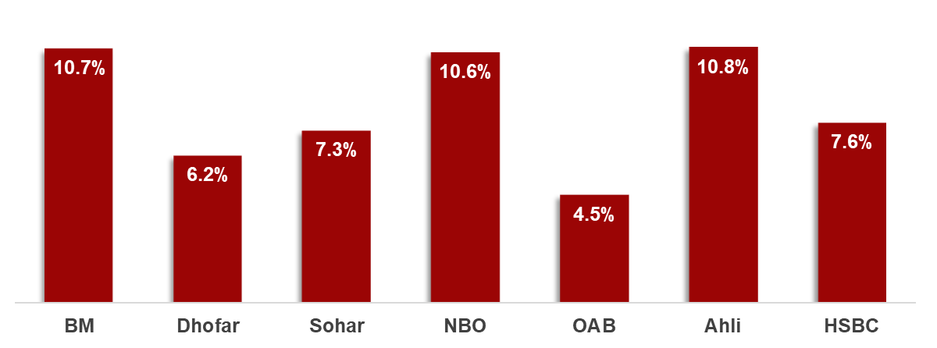
Bank Muscat - Unrivalled leading Market Position in Oman
Market Share – Total Assets¹ and Deposits²
Asset quality³ – Coverage ratio and NPL Ratio
Profitability – RoAE⁴
Capitalization
Source: Bank’s unaudited financial results Mar-23 and Central Bank of Oman Statistical Bulletin, CBO’s Oman market share report for conventional and Islamic operations Mar-23
Computation basis: ¹ Bank’s Total Assets Market share = Bank’s Total assets / Total assets as per CBO; ² Bank’s Total Deposits Market share = Bank’s Customer Deposits / Total Customer Deposits as per CBO, ³ NPL Ratio = NPL / Gross Loans, Coverage Ratio = (Loan + Non-funded provisions) / NPL, ⁴ Return on average equity = Net profit / Average of opening and closing equity attributable to equity holders for FY22

Slide 13
Bank Muscat - Dominant domestic franchise in the region
Domestic Market Share – Assets
Capitalization
Net interest margin over avg. assets
Return on avg. assets
Source: Financial results as of Dec-22 unaudited, Central Bank of Oman Statistical Bulletin
BM – Bank Muscat, SNB – Saudi National Bank (KSA), FAB – First Abu Dhabi Bank (UAE), ENBD – Emirates NBD (UAE), QNB – Qatar National Bank (Qatar), NBK – National Bank of Kuwait (Kuwait), CBQ – Commercial Bank Qatar (Qatar)

Slide 14
III. Business Overview

Slide 15
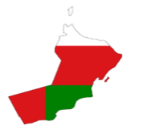

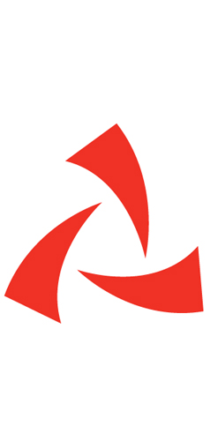




Banks Vision & Strategic Pillars
Bank Muscat Brand value
Leading financial services provider with largest branch network & innovative product and service offering
High quality service and customer centric approach through “To Serve you better, everyday” philosophy
Technology driven with multiple digital channels for sales and services
Dominant position size & proven resilience
Efficiency & Productivity
Agility & Innovation
Market Leadership
Customer Centricity
Bank Muscat
Strong Financial Position
Strong financial position, business capabilities and shareholding
Strong capital and liquidity positions
Lending power / single borrower size
Strong profitability coupled with conservative credit provisioning policies
Market share leadership in loans and deposit
Leverage on Technology And Infrastructure Investments
Pioneering investments in technology supporting growth plans
Multiple digital banking channels for sales and services
Technology driven banking to enhance customer experience and improve internal efficiency
Innovative products and services offering
Experienced Management & Young Workforce
Stable and experienced management with proven track record of successful organic and inorganic growth
Talented and young workforce
Focus on Islamic Banking Developments in Oman
Meethaq – Islamic Banking platform
Be the Market Leader in Islamic Banking Business
Endeavor to offer full fledged products and services
Expansion of branch and channel network
Creating Sustainable Value
Ensure sustainable best practices in core business activities:
  Contribution to economic performance
  Development from within
  Empowering the community
  Banking while adhering to the Bank’s corporate values
To serve you better, everyday
Leading in everything we do by offering simplified & integrated banking solutions.

Slide 16
Bank Muscat Business Lines
Business Lines Breakdown
Loan, Advances & Deposits Breakdown
 | Key Highlights | Asset Contribution | Profit Contribution
Corporate Banking | Leading corporate Banking franchise offering the full array of corporate banking services. ~ 7,200 corporate customers in Oman Strong expertise in project finance | RO 4.6 bn 35.5% of total assets | RO 15.8 mn 30.8% of total profit
Personal Banking | Leading Retail Bank platform in Oman Over 2.4 mn retail customers in Oman Largest distribution network (149 conventional branches) | RO 3.8 bn 28.9% of total assets | RO 18.0 mn 35.2% of total profit
Wholesale Banking | Comprise of treasury, corporate finance, asset management and financial institutions | RO 2.7 bn 20.7% of total assets | RO 14.0 mn 27.4% of total profit
Meethaq – Islamic Banking | RO 120 mn capital assigned to this business Officially launched in January 2013, currently operating through 26 full fledged Islamic branches | RO 1.7 bn 13.2% of total assets | RO 3.1 mn 6.1% of total profit
International Operations | Presence in Saudi Arabia & Kuwait through a branch, and 3 Rep offices and an associate across Asia | RO 0.2 bn 1.8% of total assets | RO 0.3 mn 0.6% of total profit
Loans & Advances
Deposits

Slide 17
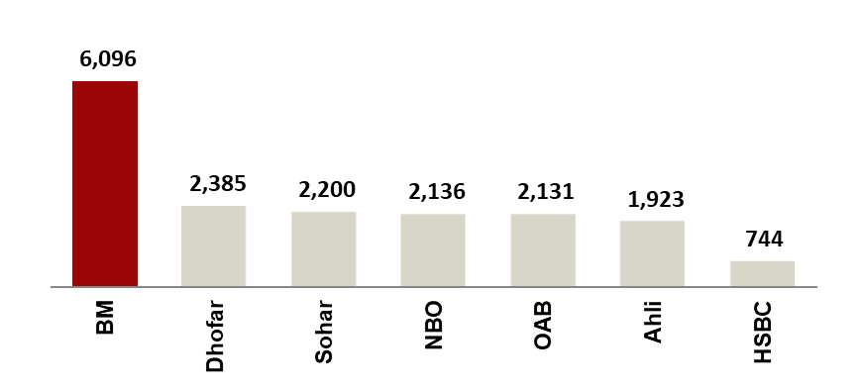
Corporate Banking
Overview
Opportunities
Strategy
Leading Corporate Banking Franchise Extensive and expanding range of products and services Strong project finance capabilities Large corporate client portfolio with c.7,200 customers and lead bank for top tier Omani corporate entities High level of sophistication differentiated through technology led investments Commitment to maintain strong control over asset quality | Large number of infrastructure/ Industrial projects in the pipeline Privatisation and diversification drive by Government Increasing business flows between Oman and regional countries | Leverage on leading position and expertise Reinforce presence in Oman across all segments in the value chain Benefit from large infrastructure and industrial projects in Oman Focus fee income generating business Transaction banking business to enhance fee income Explore cross sell opportunities among business lines Utilize presence in regional markets Grow GCC trade flows share
Corporate Loans¹
Asset Growth
Operating Income
RO mn
(RO mn, %)
(RO mn, %)
Source: Peer Banks unaudited financial statements as of Mar 2023. ¹ For comparative purposes, Corporate loans of peer banks include conventional corporate loans and Islamic corporate financing

Slide 18
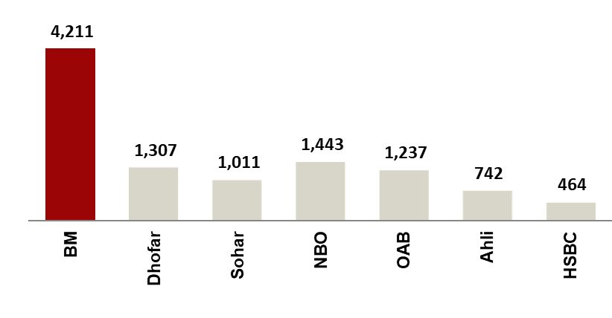
Personal Banking
Overview
Opportunities
Strategy
Leading Personal Banking Franchise in Oman Over 2.4 million customers Market leader across retail banking segments including cards, Bancassurance and remittances Largest delivery channel network in Oman in terms of branches and e-channels Best internet and mobile banking platform in Oman Substantial low-cost retail deposit base Merchant acquiring market share of over 50% by volume as of March 2023 and leading e-commerce business in Oman | Government spending resulting in job creation Increase in salaries through various government initiatives Favorable demographics Over 47% of population less than 19 years Housing finance opportunities | Leveraging on leading presence in the retail segment Increase penetration and cross sell Explore new business and product lines Technology-led product development and service offerings Enhance process efficiency and customer convenience Focus on development and utilization of e-delivery channels
Retail Loans¹
Asset Growth
Operating Income
RO mn
(RO mn)
(RO mn)
Source: Peer Bank financial statements as of Mar 2023. ¹ For comparative purposes, Retail loans of peer banks include conventional retail loans and Islamic retail financing .

Slide 19
Wholesale Banking
Overview | Opportunities | Strategy
Treasury: funding, asset and liability management requirements, offer structured solutions to corporate clients Financial Institutions: Trade, Debt Solutions and correspondent banking services Corporate Finance: Leader in corporate advisory: series of successful transactions & track record outside Oman Asset Management: Largest Omani mutual fund manager with potential for growth & expanding outside Oman. Investment solutions for high net worth individuals | Significant cross-sell opportunities to other wholesale banking clients Leverage transaction experience in attracting new corporate finance mandates Leverage regional expansion to introduce new products Strong growth potential in the high net worth market segment | Strengthen Bank Muscat’s leading position in specialised areas Utilize the presence in regional markets to expand business Leverage specialised product expertise in other markets Leverage on expertise built to further grow the market share and increase the market potential
Overview
Opportunities
Strategy
Investment Portfolio
Asset Growth
Operating Income
(RO mn)
(RO mn)
Source: Bank Muscat unaudited financial statements as of Mar 2023

Slide 20
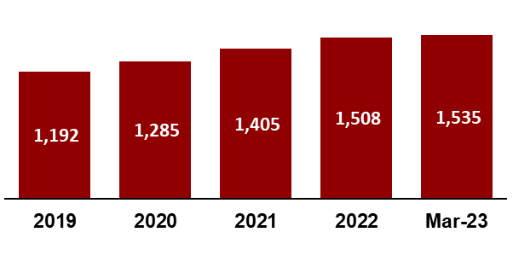
Meethaq – Islamic Banking
Overview
Opportunities
Strategy
One of the most successful Islamic banking operations in Oman since 2013 26 dedicated branches throughout the Sultanate Innovation in product offering and services to create a niche Established Sharia Board comprising of experienced and reputable Sharia scholars | Growth momentum continued since the launch indicating potential in the market Shari’a governance structure ensures transparent banking Large network at disposal to leverage business Awareness drives on Shari’a compliant banking to increase customer base | Full fledged product and service offerings Increase Meethaq exclusive branch network to an optimum level Customer Centric approach and transparency Technology driven customer service delivery within the Shari’a compliance ambit
Gross Financing Portfolio
Operating Income
(RO mn)
(RO mn)
Source: Bank Muscat unaudited financial statements as of Mar 2023

Slide 21

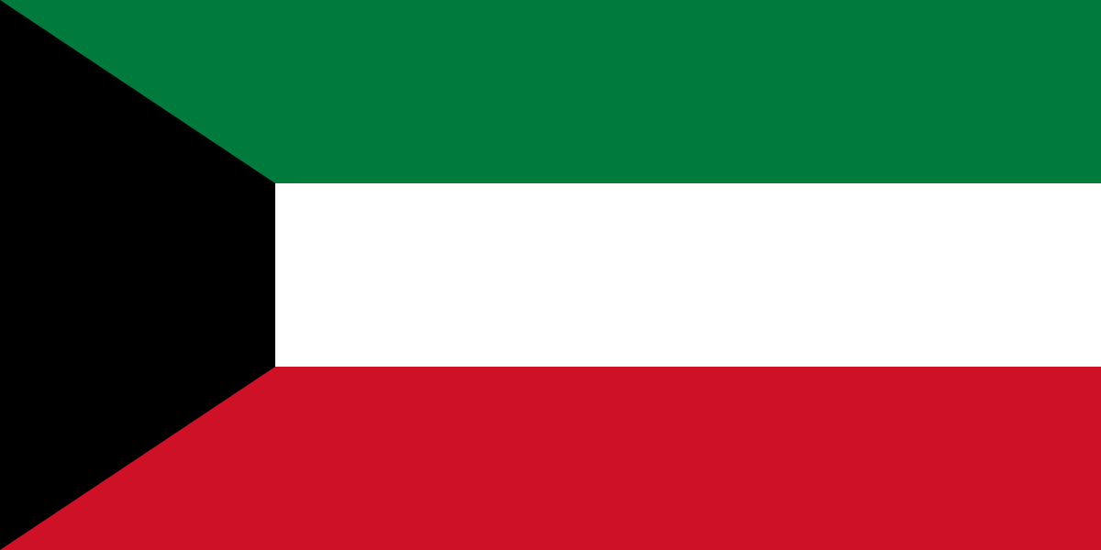
International Operations
Country | Entity | Overview & Strategy
Kingdom of Saudi Arabia | Bank Muscat Riyadh Branch | Focus on bulk deposits from large corporate and HNI clientele Enhance scale through continued focus on corporate, trade and treasury businesses Selective approach to asset growth – medium-size ticket, contract-backed funded & unfunded business. Cost containment and increase shared resources with Head Office
State of Kuwait | Bank Muscat Kuwait Branch | In June 2022, Bank Muscat disclosed it intends to gradually reduce the operations of its branch in Kuwait Aiming for complete closure of the branch by 2025 The branch constitutes only about 0.5% of the Bank’s total assets
The bank has representative offices in UAE, Singapore and Iran to support corporate, trade and financial institutions businesses.
In October 2022, Bank sold its remaining stake of 27.29% in SICO Capital KSA (previously Muscat Capital) and acquired an additional stake of 2.76% in SICO BSC (c), increasing bank’s shareholding in SICO BSCs to 13.14%.

Slide 22
IV. Financial Performance

Slide 23
Financial Highlights – Q1-2023 (YTD Mar 23)
Bank Muscat continued to weather the global and regional challenges in March 2023 & achieved a Net Profit of RO 51 mn (c. 6.3% increase vs. March 2022)
Operating Income reached RO 123 mn in Q1-23 (c. 8.2% higher vs. Q1-22)
Net Interest Income and Income from Islamic financing reached RO 92 mn in Q1-23 (c. 11.7% higher vs. Q1-22)
Net Loans and Islamic Financing increased YoY by RO 753 mn or 8.4% to RO 9,762 mn.
Customer Deposits including Islamic customer deposits increased YoY by RO 139 mn or 1.6% to RO 8,992 mn.
Other income achieved in Q1-23 was RO 31 mn (c. 1% lower vs. Q1-22)
Operating expenses were RO 49 mn in Q1-23 (c. 6.4% higher vs. Q1-22)
Net Impairment was RO 14 mn (c. RO 1.7 mn higher vs Q1-22).

Slide 24
Operating Performance & Profitability
Overview
Net Interest Spread
Resilient operating performance Stable top line income growth over the years Stable cost to income ratio with marginal growth in costs: Solid profitability Stable Return on Assets Strong core revenue generation with net interest income and commission & fees over 93% of total operating income Increasing focus on top line commission & fee income generation Stable Net Interest Margin over the last few years In Q1-23, commission & other income forms 26% of bank’s operating income
Operating Income & Cost to Income
Profitability
RO mn
RO mn
Source: Bank Muscat unaudited financial statements as of Mar 2023

Slide 25
Asset Quality
Overview
Loan Growth (RO Mn)
Stable loan book growth Conservative lending approach Focus on high quality assets with access to top tier borrowers Strong project finance capabilities As at Mar-23, Corporate and retail loan mix is 59:41 Diversified loan portfolio across sectors Conservative provisioning of impaired assets: Provisioning in compliance with IFRS 9
Stage wise Gross Loans
Impaired Assets & Provisioning (RO Mn)
Source: Bank Muscat unaudited financial statements as of Mar 2023
Provision coverage = Impairment on Loans & advances & non-funded impairments / Impaired Loans

Slide 26
Funding & Liquidity
Overview
Funding Mix
Stable funding structure with a diversified funding base Largest deposit base in Oman with significant granularity Deposits from individuals comprise c44% of total customer deposits Top 20 depositors represent 33% of total deposits and comprise of top tier Omani institutions Strong capitalization levels Highest CAR in Omani peers and one of strongest in GCC peers Robust capital position Total CAR at 20.53% & Tier 1 at 19.59% Minimum regulatory requirement of 13.25 % and 11.25% respectively CASA contributing to nearly 66% of total deposits. Bank Muscat also has the highest market shares in saving deposits
Liquid Assets
Capital Adequacy Ratio
RO mn
Source: Bank Muscat unaudited financial statements as of Mar 2023
Notes:
In this slide, we talk about the funding and liquidity situation of the Bank.
The Bank has a well-balanced funding mix with around 70% of the funding coming from customer deposits and the balance through interbank borrowings and equity. This has been a stable position for the last few years.
The Bank continues to hold high level of liquid assets over the last 5 years. These assets are in the form of very high-quality liquid assets.
As mentioned earlier, the Bank’s capital position is one of the highest among Omani peers, and one of the strongest among GCC peers as well.
The capital position is largely driven by core equity capital along with retained profits after paying healthy dividends over the last many years.
يتمتع البنك بمزيج تمويل متوازن حيث يأتي حوالي 70٪ من التمويل من ودائع العملاء والمتبقي من خلال الاقتراض بين البنوك وحقوق الملكية. لقد كان هذا الوضع مستقرًا خلال السنوات القليلة الماضية.
استمر البنك في الاحتفاظ بمستوى عالٍ من الأصول السائلة في السنوات الخمس الماضية. تعتبر هذه الأصول أصولاً سائلة عالية الجودة.
كما ذكرنا سابقًا، يعتبر مركز رأس المال للبنك من أعلى المراكز بين أقرانه العمانيين وأحد الأقوى بين أقرانه في دول مجلس التعاون الخليجي.

Slide 27
V. Annexures

Slide 28
Balance Sheet

Slide 29
Profit & Loss Statement
Note: Certain corresponding figures for prior years have been reclassified in order to conform to the presentation for the current year. Such reclassifications do not affect previously reported profit or equity.

